Slide 1
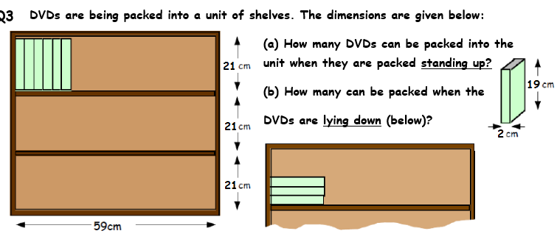
Shelf Packing
Example 1
(c) What is the best way to store the DVDs so that the maximum number can be stored?

Slide 2
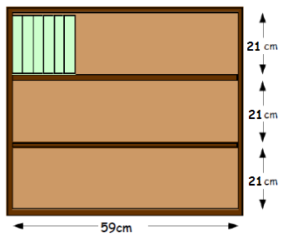
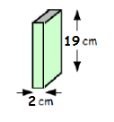
Example 1
(a) How many DVDs can be packed into the unit when they are packed vertically (standing up)?
One Shelf
Three Shelves
59 ÷ 2
29 x 3
= 29.5
= 87 DVDs
29 dvds

Slide 3
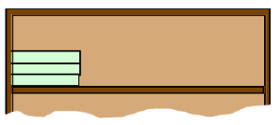

Example 1
(b) How many can be packed when the DVDs are packed horizontally (lying down)?
How many can fit along the shelf?
How many high?
21 ÷ 2 = 10.5
10 DVDs
59 ÷ 19 = 3.10…
= 3 DVDs
Three Shelves
Multiply to get total for one shelf
3 x 10
= 30 DVDs in total
30 x 3
= 90 DVDs

Slide 4
Example 1
(c) What is the best way to store the DVDs so that the maximum number can be stored?
Vertically
Horizontally
87 DVDs
90 DVDs
Maximum = the most
The best way to store the DVDs would be horizontally.
This allows to store 90 DVDs.
3 more than if they were stored vertically.

