Slide 1
Scatter Graphs MENU
Leaf Length / Width
Summary
Car Age / Value
Which type of correlation ?
Height / Maths Score
Questions / Answers
Main MENU

Slide 2
Scatter Graphs.
Menu

Slide 3
I could then draw a Scatter Graph to see if there is a correlation between the length and the width of water plant leaves.
I wonder if water plant leaves grow wider as they grow longer.
If I measure their lengths
and then measure their widths
Menu

Slide 4
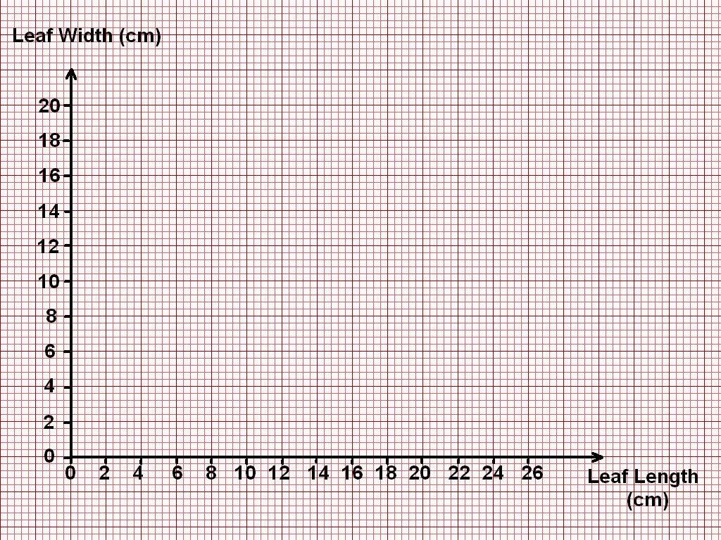
L | 6 | 20 | 10 | 2 | 18 | 12 | 14 | 9 | 8 | 15 | 23 | 16 | 17 | 25
W | 5 | 15 | 9 | 1 | 14 | 11 | 14 | 7 | 7 | 11 | 17 | 13 | 12 | 18
Line Of Best Fit
X
W
X
15 cm
X
The plots are in a sort of straight line !
I can therefore draw in a Line Of Best Fit.
L
X
X
X
X
How wide would you expect a 19 cm long leaf to be ?
X
X
How long would you expect a 10 cm wide leaf to be ?
X
Positive Correlation
As one quantity increases so does
the other.
The line slopes from bottom left to top right.
X
X
As the leaves get longer they also get wider.
X
X
12.8 cm
Menu

Slide 5
I wonder if there is a connection between the age of a car and its value.
Menu

Slide 6
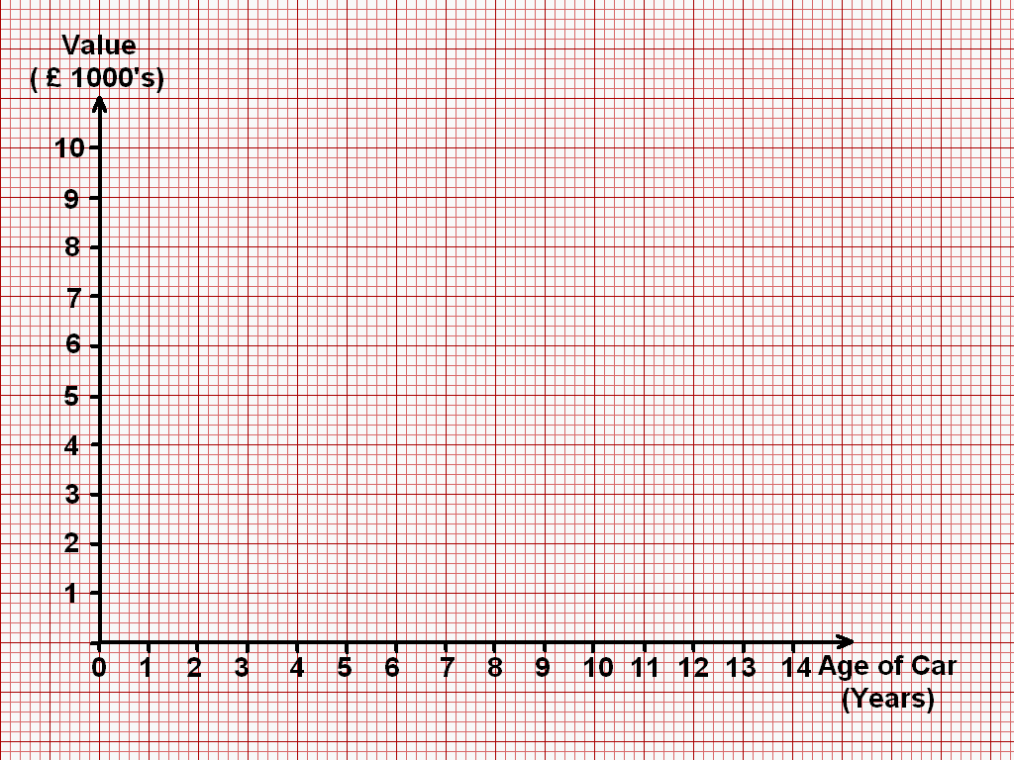
A | 1 | 5 | 14 | 7 | 11 | 7 | 6 | 10 | 2 | 10 | 9 | 14 | 4 | 8
V | 9 | 6 | 1 | 5 | 3 | 6 | 8 | 4 | 9 | 3 | 5 | 2 | 7 | 6
How old should a car be when it is worth
£ 7000 ?
x
It’s an OUTLIER.
I will just ignore it !
How much should an 8 year old car be worth ?
X
X
Negative Correlation
As one quantity increases
the other decreases.
The line slopes from top left
bottom right.
X
As the Age increases, the Value Decreases.
X
X
X
X
X
X
£ 5100
X
X
X
X
X
5 years
Menu

Slide 7
I think that tall people are better at Maths than short people !
No way !
Menu

Slide 8
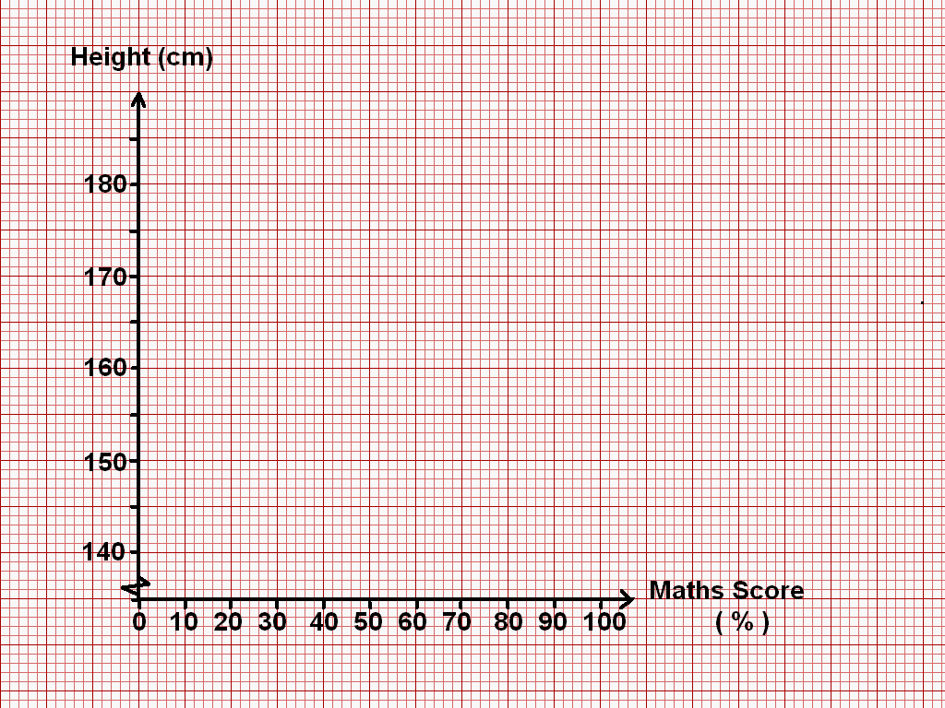
% | 10 | 30 | 90 | 50 | 30 | 70 | 60 | 50 | 20 | 85 | 55 | 35 | 40
H | 180 | 160 | 170 | 170 | 140 | 145 | 150 | 175 | 140 | 155 | 150 | 150 | 145
I don’t seem to be able to draw in a Line of Best Fit !
That is because there is no correlation !
X
X
X
X
X
X
X
X
X
X
X
X
X
Menu

Slide 9
SUMMARY
X
X
X
X
X
X
X
X
X
X
X
X
X
X
X
X
X
X
X
X
X
X
X
X
X
X
X
X
Strong Positive Correlation
Strong Negative Correlation
No Correlation
x
x
x
x
x
x
x
x
x
x
x
x
x
x
x
x
Ignore Outliers
x
x
x
x
x
Weak Positive Correlation
Weak Negative Correlation
Menu

Slide 10
Which type of Correlation ?
1)
2)
Score in Maths Exam
3)
Height
Weight
Negative
Correlation
x
x
x
x
x
x
Positive
Correlation
x
x
x
x
x
x
No
Correlation
x
x
x
x
x
x
x
x
x
Weight
Score in Art Exam
Hours Spent Exercising
4)
Life Expectancy
5)
Shot Put Distance
6)
Maths Exam Mark
Negative
Correlation
x
x
x
x
x
x
x
x
x
x
Positive
Correlation
x
Positive
Correlation
x
x
x
x
x
x
x
x
x
Cigarettes Smoked per Day
Time for 100 m
Hours Spent Revising
Menu

Slide 11
Plot the following data on Scatter Graphs and use their Lines Of Best Fit to answer the questions.
1) Thirteen students recorded their Maths and Science scores as follows :
Maths % | 90 | 45 | 72 | 24 | 55 | 83 | 42 | 12 | 36 | 66 | 82 | 25 | 30
Science % | 85 | 52 | 68 | 30 | 58 | 87 | 35 | 8 | 41 | 70 | 74 | 30 | 41
What would you expect a student who got 77 % in Maths to get in Science ?
What would you expect a student who got 50 % in Science to get in Maths ?
Describe the type of Correlation.
Answer
2) Twelve pupils had their Maths results recorded against the number of days absent from school :
Maths % | 60 | 20 | 90 | 60 | 30 | 80 | 33 | 96 | 48 | 50 | 10 | 62
Days absent | 10 | 25 | 10 | 23 | 25 | 10 | 30 | 40 | 25 | 20 | 35 | 16
How many days absent would you expect a pupil to have had who scored 40 % in their Maths exam ?
What Maths score would you predict for a pupil who has had 15 days of absence ?
Describe the Correlation.
Answer
Menu

Slide 12
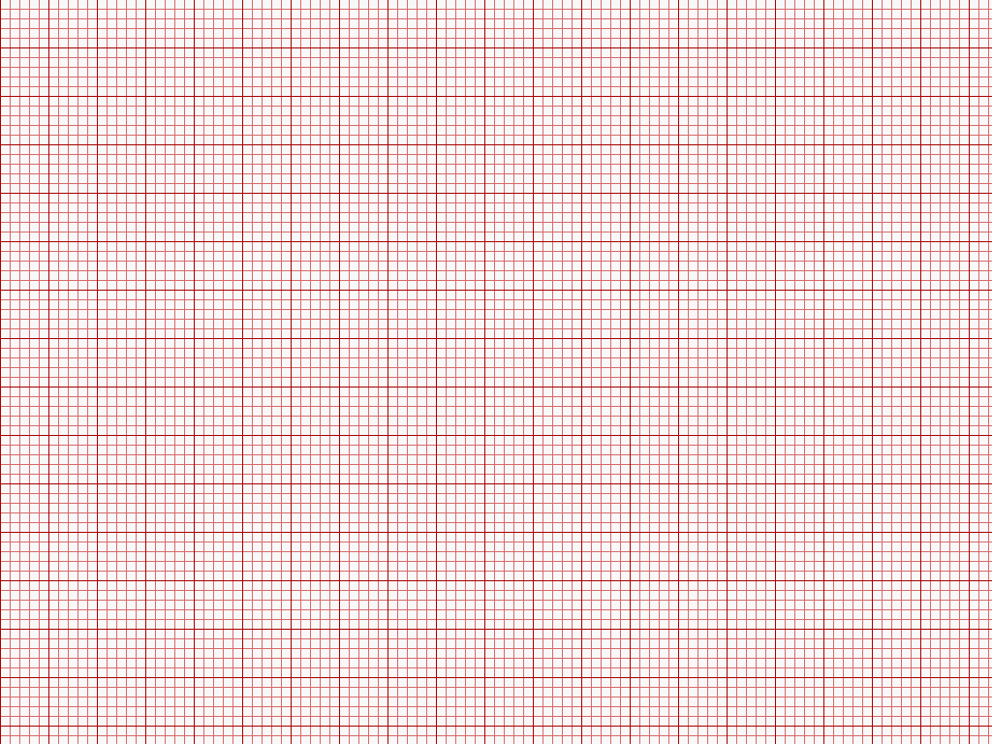
Science %
77 % in Maths
77 % in Science
90
80
70
60
50
40
30
20
10
0
x
x
b) 50 % in Science
47 % in Maths.
x
x
x
x
c) Positive
Correlation.
x
x
x
x
x
x
x
Maths %
0 10 20 30 40 50 60 70 80 90 100
Menu
Questions

Slide 13
40 % in Maths
24 days absent.
Days Absent
40
35
30
25
20
15
10
5
0
x
b) 15 days absent
63 % in Maths.
x
x
c) Negative
Correlation.
x
x
x
x
x
x
x
x
x
Maths %
0 10 20 30 40 50 60 70 80 90 100
Menu
Questions

Slide 14
End of Scatter Graphs Presentation.
Return to previous slide.

