Slide 1
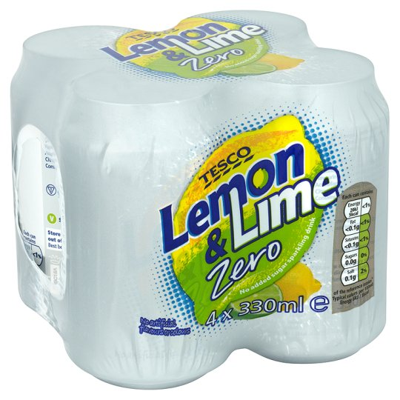
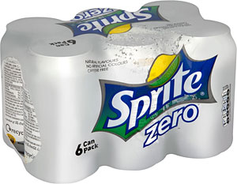
Which pack of lemonade is the best value?
Pack of 4
Cost £1.20
Pack of 6
Cost £1.60

Slide 2


A pack of 9 kitchen rolls costs £4.50.
A pack of 11 kitchen rolls costs 8.80.
Which one should you buy?

Slide 3

Which shop is best value for money?
Adam’s Apples
65 apples for £15.21
Phillip’s Fruit
45 apples for £10.44

