Slide 1
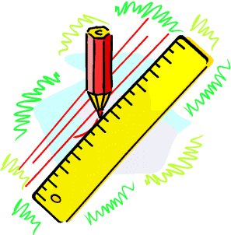
Higher Unit 1
Applications 1.2
The Graphical Form of the Circle Equation
Intersection Form of the Circle Equation
Find intersection points between a Line & Circle
Tangency (& Discriminant) to the Circle
Equation of Tangent to the Circle
Mind Map of Circle Chapter
Exam Type Questions

Slide 2
The Circle
The distance from (a,b) to (x,y) is given by
r² = (x - a)² + (y - b)²
Proof
(x , y)
r
(y – b)
(a , b)
(x , b)
By Pythagoras
(x – a)
r² = (x - a)² + (y - b)²

Slide 3
Equation of a Circle
Centre at the Origin
OP has length r
r is the radius of the circle
y-axis
By Pythagoras Theorem
c
b
a
a²+b²=c²
y
P(x,y)
r
O
x
x-axis
Notes:
We start by find the equation of a circle centre the origin.
First draw set axises x,y and then label the origin O.
Next we plot a point P say, which as coordinates x,y.
Next draw a line from the origin O to the point P and label
length of this line r.
If we now rotate the point P through 360 degrees keep the Origin fixed we trace out a circle with radius r and centre O.
Remembering Pythagoras’s Theorem from Standard grade
a square plus b squared equal c squares we can now write down the equal of any circle with centre the origin.

Slide 4
The Circle
Find the centre and radius of the circles below
x² + y² = 7
centre (0,0) & radius = √7
x² + y² = ¹/₉
centre (0,0) & radius = ¹/₃

Slide 5
General Equation of a Circle
y-axis
CP has length r
y
P(x,y)
r is the radius of the circle
with centre (a,b)
r
y-b
By Pythagoras Theorem
b
C(a,b)
x-a
Centre C(a,b)
O
a
x
x-axis
c
b
To find the equation of a circle you need to know
a
a²+b²=c²
Centre C (a,b) and radius r
OR
Centre C (a,b) and point on the circumference of the circle
Notes:
We are now in a position to find the equation of any circle with centre A,B.
All we have to do is repeat the process in shown in slide 2, but this time the centre is chosen to be (a,b).
First plot a point C and label it’s coordinates (a,b), next we plot another point P and label it’s coordinates (x,y).
Next draw a line from C to P and call this length (r).
(r) will be the radius of our circle with centre (a,b).
Again we rotate the point P through 360 degrees keeping the point C fixed.
Using Pythagoras Theorem a squared plus b squared equal c squared we can write down the equation of any circle with centre (a,b) and radius (r).
The equation is (x - a) all squared plus (y-b) all squared equals (r) squared.
Finally to write down the equation of a circle we need to know the co-ordinates of the centre and the length of the radius or co-ordinates of the centre and the co-ordinates of a point on the circumference of the circle.

Slide 6
The Circle
Examples
(x-2)² + (y-5)² = 49
centre (2,5)
radius = 7
Demo
(x+5)² + (y-1)² = 13
centre (-5,1)
radius = √13
(x-3)² + y² = 20
centre (3,0)
radius = √20
= √4 X √5
= 2√5
Centre (2,-3) & radius = 10
Equation is (x-2)² + (y+3)² = 100
NAB
Centre (0,6) & radius = 2√3
r² = 2√3 X 2√3
= 4√9
Equation is x² + (y-6)² = 12
= 12

Slide 7
The Circle
Example
P
Find the equation of the circle that has PQ as diameter where P is(5,2) and Q is(-1,-6).
C
Q
C is (⁽⁵⁺⁽⁻¹⁾⁾/₂,⁽²⁺⁽⁻⁶⁾⁾/₂)
= (2,-2)
= (a,b)
CP² = (5-2)² + (2+2)²
= 9 + 16
= 25 = r²
Using (x-a)² + (y-b)² = r²
Equation is (x-2)² + (y+2)² = 25

Slide 8
The Circle
Example
Two circles are concentric. (ie have same centre)
The larger has equation (x+3)² + (y-5)² = 12
The radius of the smaller is half that of the larger. Find its equation.
Using (x-a)² + (y-b)² = r²
Centres are at (-3, 5)
Larger radius = √12
= √4 X √3
= 2 √3
Smaller radius = √3
so r² = 3
Required equation is (x+3)² + (y-5)² = 3

Slide 9
Inside / Outside or On Circumference
When a circle has equation (x-a)² + (y-b)² = r²
If (x,y) lies on the circumference then (x-a)² + (y-b)² = r²
If (x,y) lies inside the circumference then (x-a)² + (y-b)² < r²
If (x,y) lies outside the circumference then (x-a)² + (y-b)² > r²
Example
Taking the circle (x+1)² + (y-4)² = 100
Determine where the following points lie;
K(-7,12) , L(10,5) , M(4,9)

Slide 10
Inside / Outside
or On Circumference
At K(-7,12)
(x+1)² + (y-4)² =
(-7+1)² + (12-4)² =
(-6)² + 8²
= 36 + 64 = 100
So point K is on the circumference.
At L(10,5)
(x+1)² + (y-4)² =
(10+1)² + (5-4)² =
11² + 1²
= 121 + 1 = 122
> 100
So point L is outside the circumference.
At M(4,9)
(x+1)² + (y-4)² =
(4+1)² + (9-4)² =
5² + 5²
= 25 + 25 = 50
< 100
So point M is inside the circumference.

Slide 11
HHM Practice
HHM Ex12D
HHM Ex12F

Slide 12
Intersection Form of the Circle Equation
1.
Centre C(a,b)
Radius r
2.
Centre C(-g,-f)
Radius r
Notes:
We have derived the general equation of any circle with centre (a,b) and radius ®, this is given at the top of the slide.
We can re-write this equation into a different format given at the bottom of the slide.
The reason for doing so, is that this format can be much more useful when dealing with certain types of questions.
To get to this equivalent form we multiply out the bracket in our original equation.
Then we gather each of the different terms together.
Then we equate the LHS of the equation to zero, by subtracting r squared from each side.
We then we tidy up the equation further by letting g= - a , f = -b and the constant term c = a squared plus b squared minus r squared.
This gives us the equivalent form of the general equation at the bottom of the slide.
Note that in this format the centre is given by (-g, -f ) since a=-g and b=-f.
Also by rearranging the expression for c we can deduce the formula for the radius r.
r=square root of g2+f2-c.

Slide 13
Equation x² + y² + 2gx + 2fy + c = 0
Example
Write the equation (x-5)² + (y+3)² = 49 without brackets.
(x-5)² + (y+3)² = 49
(x-5)(x+5) + (y+3)(y+3) = 49
x² - 10x + 25 + y² + 6y + 9 – 49 = 0
x² + y² - 10x + 6y -15 = 0
This takes the form given above where
2g = -10 , 2f = 6 and c = -15

Slide 14
Equation
x² + y² + 2gx + 2fy + c = 0
Example
Show that the equation x² + y² - 6x + 2y - 71 = 0
represents a circle and find the centre and radius.
x² + y² - 6x + 2y - 71 = 0
x² - 6x + y² + 2y = 71
(x² - 6x + 9) + (y² + 2y + 1) = 71 + 9 + 1
(x - 3)² + (y + 1)² = 81
This is now in the form (x-a)² + (y-b)² = r²
So represents a circle with centre (3,-1) and radius = 9

Slide 15
Equation
x² + y² + 2gx + 2fy + c = 0
Example
We now have 2 ways on finding the centre and radius of a circle depending on the form we have.
x² + y² - 10x + 6y - 15 = 0
2g = -10
c = -15
2f = 6
g = -5
f = 3
centre = (-g,-f)
= (5,-3)
radius = √(g² + f² – c)
= √(25 + 9 – (-15))
= √49
= 7

Slide 16
Equation
x² + y² + 2gx + 2fy + c = 0
Example
x² + y² - 6x + 2y - 71 = 0
2g = -6
c = -71
2f = 2
g = -3
f = 1
centre = (-g,-f)
= (3,-1)
radius = √(g² + f² – c)
= √(9 + 1 – (-71))
= √81
= 9

Slide 17
Equation
x² + y² + 2gx + 2fy + c = 0
Example
Find the centre & radius of x² + y² - 10x + 4y - 5 = 0
x² + y² - 10x + 4y - 5 = 0
NAB
c = -5
2g = -10
2f = 4
g = -5
f = 2
centre = (-g,-f)
= (5,-2)
radius = √(g² + f² – c)
= √(25 + 4 – (-5))
= √34

Slide 18
Equation
x² + y² + 2gx + 2fy + c = 0
Example
The circle x² + y² - 10x - 8y + 7 = 0 cuts the y- axis at A & B. Find the length of AB.
At A & B x = 0 so the equation becomes
Y
A
y² - 8y + 7 = 0
(y – 1)(y – 7) = 0
B
y = 1 or y = 7
X
A is (0,7) & B is (0,1)
So AB = 6 units

Slide 19
Application of Circle Theory
Frosty the Snowman’s lower body section can be represented by the equation
x² + y² – 6x + 2y – 26 = 0
His middle section is the same size as the lower but his head is only ¹/₃ the size of the other two sections. Find the equation of his head !
x² + y² – 6x + 2y – 26 = 0
radius = √(g² + f² – c)
2g = -6
2f = 2
c = -26
g = -3
f = 1
= √(9 + 1 + 26)
= √36
centre = (-g,-f)
= (3,-1)
= 6

Slide 20
Working with Distances
(3,19)
2
radius of head = 1/3 of 6 = 2
6
Using (x-a)² + (y-b)² = r²
(3,11)
Equation is (x-3)² + (y-19)² = 4
6
6
(3,-1)

Slide 21
Working with Distances
Example
By considering centres and radii prove that the following two circles touch each other.
Circle 1 x² + y² + 4x - 2y - 5 = 0
Circle 2 x² + y² - 20x + 6y + 19 = 0
Circle 1 2g = 4 so g = 2
Circle 2 2g = -20 so g = -10
2f = -2 so f = -1
2f = 6 so f = 3
c = -5
c = 19
centre = (-g, -f)
= (-2,1)
centre = (-g, -f)
= (10,-3)
radius = √(g² + f² – c)
radius = √(g² + f² – c)
= √(4 + 1 + 5)
= √(100 + 9 – 19)
= √10
= √90
= √9 X √10
= 3√10

Slide 22
Working with Distances
If d is the distance between the centres then
d² = (x₂-x₁)² + (y₂-y₁)²
= (10+2)² + (-3-1)²
= 144 + 16
= 160
d = √160
= √16 X √10
= 4√10
r2
r1
radius1 + radius2
= √10 + 3√10
= 4√10
It now follows that the circles touch !
= distance between centres

Slide 23
HHM Practice
HHM Ex12G
HHM Ex12H

Slide 24
Intersection of Lines
& Circles
There are 3 possible scenarios
2 points of contact
1 point of contact
0 points of contact
discriminant
line is a tangent
discriminant
discriminant
(b²- 4ac < 0)
(b²- 4ac > 0)
(b²- 4ac = 0)
To determine where the line and circle meet we use simultaneous equations and the discriminant tells us how many solutions we have.

Slide 25
Intersection of Lines
& Circles
Why do we talk of a “discriminant”?
Remember: we are considering where a line
(y = mx +c) ......... (1)
meets a circle
(x² + y² + 2gx + 2fy + c = 0) ......... (2)
When we solve these equations simultaneously, we get a quadratic ! This means that the solution depends on the discriminant !
(b²- 4a > 0)
(b²- 4ac = 0)
(b²- 4ac < 0)

Slide 26
Intersection of Lines
& Circles
Example
Find where the line y = 2x + 1 meets the circle
(x – 4)² + (y + 1)² = 20 and comment on the answer
Replace y by 2x + 1 in the circle equation
(x – 4)² + (y + 1)² = 20
becomes (x – 4)² + (2x + 1 + 1)² = 20
(x – 4)² + (2x + 2)² = 20
x ² – 8x + 16 + 4x ² + 8x + 4 = 20
5x ² = 0
x ² = 0
x = 0 one solution tangent point
Using y = 2x + 1, if x = 0 then y = 1
Point of contact is (0,1)

Slide 27
Intersection of Lines
& Circles
Example
Find where the line y = 2x + 6 meets the circle x² + y² + 10x – 2y + 1 = 0
Replace y by 2x + 6 in the circle equation
x² + y² + 10x – 2y + 1 = 0
becomes x² + (2x + 6)² + 10x – 2(2x + 6) + 1 = 0
x ² + 4x² + 24x + 36 + 10x – 4x - 12 + 1 = 0
5x² + 30x + 25 = 0
( ÷5 )
x ² + 6x + 5 = 0
(x + 5)(x + 1) = 0
x = -5 or x = -1
Points of contact are
(-5,-4) and (-1,4).
Using y = 2x + 6
if x = -5 then y = -4
if x = -1 then y = 4

Slide 28
HHM Practice
HHM Ex12J

Slide 29
Tangency
Example
Prove that the line 2x + y = 19 is a tangent to the circle x² + y² - 6x + 4y - 32 = 0 , and also find the point of contact.
2x + y = 19 so y = 19 – 2x
NAB
Replace y by (19 – 2x) in the circle equation.
x² + y² - 6x + 4y - 32 = 0
x² + (19 – 2x)² - 6x + 4(19 – 2x) - 32 = 0
x² + 361 – 76x + 4x² - 6x + 76 – 8x - 32 = 0
5x² – 90x + 405 = 0
Using y = 19 – 2x
( ÷5)
x² – 18x + 81 = 0
If x = 9 then y = 1
(x – 9)(x – 9) = 0
Point of contact is (9,1)
x = 9 only one solution hence tangent

Slide 30
Using Discriminants
At the line x² – 18x + 81 = 0 we can also show there is only one solution by showing that the discriminant is zero.
For x² – 18x + 81 = 0 , a =1, b = -18 and c = 81
So b² – 4ac =
(-18)² – 4 X 1 X 81
= 364 - 364
= 0
Since disc = 0 then equation has only one root so there is only one point of contact so line is a tangent.
The next example uses discriminants in a slightly different way.

Slide 31
Using Discriminants
Example
Find the equations of the tangents to the circle x² + y² – 4y – 6 = 0 from the point (0,-8).
x² + y² – 4y – 6 = 0
2g = 0 so g = 0
Each tangent takes the form y = mx -8
2f = -4 so f = -2
Replace y by (mx – 8) in the circle equation
Centre is (0,2)
to find where they meet.
This gives us …
Y
x² + y² – 4y – 6 = 0
(0,2)
x² + (mx – 8)² – 4(mx – 8) – 6 = 0
x² + m²x² – 16mx + 64 –4mx + 32 – 6 = 0
(m²+ 1)x² – 20mx + 90 = 0
-8
In this quadratic
a = (m²+ 1)
b = -20m
c =90

Slide 32
Tangency
For tangency we need discriminate = 0
b² – 4ac = 0
(-20m)² – 4 X (m²+ 1) X 90 = 0
400m² – 360m² – 360 = 0
40m² – 360 = 0
40m² = 360
m² = 9
m = -3 or 3
So the two tangents are
y = -3x – 8 and y = 3x - 8
and the gradients are reflected in the symmetry of the diagram.

Slide 33
HHM Practice
HHM Ex12K

Slide 34
Equations of Tangents
NB: At the point of contact
a tangent and radius/diameter are perpendicular.
Tangent
radius
This means we make use of m₁m₂ = -1.

Slide 35
Equations of Tangents
Example
Prove that the point (-4,4) lies on the circle x² + y² – 12y + 16 = 0
NAB
Find the equation of the tangent here.
At (-4,4) x² + y² – 12y + 16
= 16 + 16 – 48 + 16
= 0
So (-4,4) must lie on the circle.
x² + y² – 12y + 16 = 0
2g = 0 so g = 0
2f = -12 so f = -6
Centre is (-g,-f) = (0,6)

Slide 36
Equations of Tangents
y₂ – y₁ x₂ – x₁
Gradient of radius =
= ^{(6 – 4)}/₍₀ ₊ ₄₎
(0,6)
= ²/₄
(-4,4)
= ¹/₂
So gradient of tangent = -2
( m₁m₂ = -1)
Using y – b = m(x – a)
We get y – 4 = -2(x + 4)
y – 4 = -2x - 8
y = -2x - 4

Slide 37
HHM Practice
HHM Ex12L

Slide 38
Special case

Slide 39

www.maths4scotland.co.uk
Higher Maths
Strategies
The Circle
Click to start

Slide 40
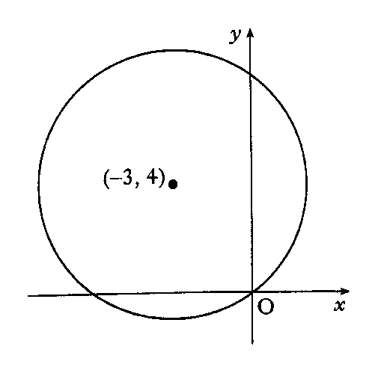


Maths4Scotland Higher
Find the equation of the circle with centre
(–3, 4) and passing through the origin.
Find radius (distance formula):
You know the centre:
Write down equation:
Hint
Previous
Quit
Quit
Next

Slide 41
Maths4Scotland Higher
Explain why the equation
does not represent a circle.
Consider the 2 conditions
1. Coefficients of x² and y² must be the same.
2. Radius must be > 0
Calculate g and f:
Evaluate
Deduction:
Equation does not represent a circle
Hint
Previous
Quit
Quit
Next

Slide 42
Maths4Scotland Higher
Find the equation of the circle which has P(–2, –1) and Q(4, 5)
as the end points of a diameter.
Q(4, 5)
Make a sketch
C
P(-2, -1)
Calculate mid-point for centre:
Calculate radius CQ:
Write down equation;
Hint
Previous
Quit
Quit
Next

Slide 43
Maths4Scotland Higher
Find the equation of the tangent at the point (3, 4) on the circle
Calculate centre of circle:
P(3, 4)
Make a sketch
O(-1, 2)
Calculate gradient of OP (radius to tangent)
Gradient of tangent:
Equation of tangent:
Hint
Previous
Quit
Quit
Next

Slide 44
Maths4Scotland Higher
The point P(2, 3) lies on the circle
Find the equation of the tangent at P.
Find centre of circle:
P(2, 3)
Make a sketch
O(-1, 1)
Calculate gradient of radius to tangent
Gradient of tangent:
Equation of tangent:
Hint
Previous
Quit
Quit
Next

Slide 45
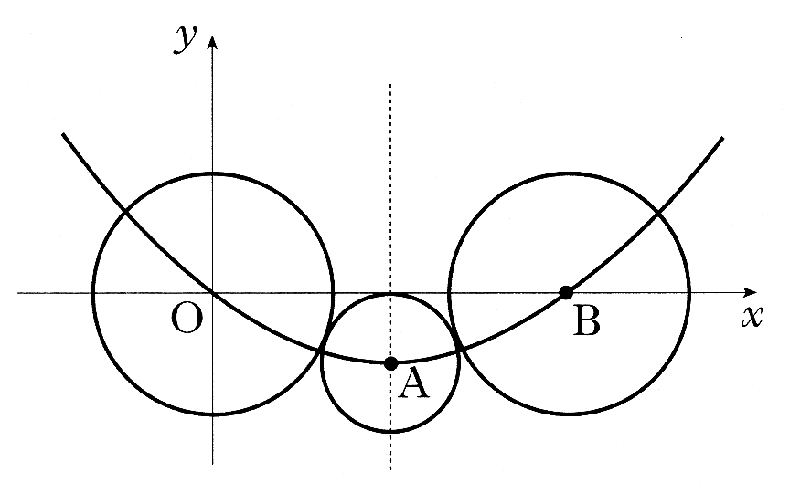
Maths4Scotland Higher
O, A and B are the centres of the three circles shown in
the diagram. The two outer circles are congruent, each
touches the smallest circle. Circle centre A has equation
The three centres lie on a parabola whose axis of symmetry
is shown the by broken line through A.
a) i) State coordinates of A and find length of line OA.
ii) Hence find the equation of the circle with centre B.
b) The equation of the parabola can be written in the form
Find p and q.
A is centre of small circle
Find OA (Distance formula)
Use symmetry, find B
Find radius of circle A from eqn.
Find radius of circle B
Eqn. of B
Points O, A, B lie on parabola – subst. A and B in turn
Solve:
Hint
Previous
Quit
Quit
Next

Slide 46
Maths4Scotland Higher
Circle P has equation Circle Q has centre (–2, –1) and radius 2√2.
a) i) Show that the radius of circle P is 4√2
ii) Hence show that circles P and Q touch.
b) Find the equation of the tangent to circle Q at the point (–4, 1)
c) The tangent in (b) intersects circle P in two points. Find the x co-ordinates of the points of
intersection, expressing your answers in the form
Find centre of circle P:
Find radius of circle :P:
Find distance between centres
Deduction:
= sum of radii, so circles touch
Gradient of radius of Q to tangent:
Gradient tangent at Q:
Equation of tangent:
Solve eqns. simultaneously
Soln:
Hint
Previous
Quit
Quit
Next

Slide 47
Maths4Scotland Higher
For what range of values of k does the equation
represent a circle ?
Determine g, f and c:
State condition
Put in values
Simplify
Need to see the position
of the parabola
Complete the square
Minimum value is
This is positive, so graph is:
Expression is positive for all k:
So equation is a circle for all values of k.
Hint
Previous
Quit
Quit
Next

Slide 48
Maths4Scotland Higher
For what range of values of c does the equation
represent a circle ?
Determine g, f and c:
State condition
Put in values
Simplify
Re-arrange:
Hint
Previous
Quit
Quit
Next

Slide 49
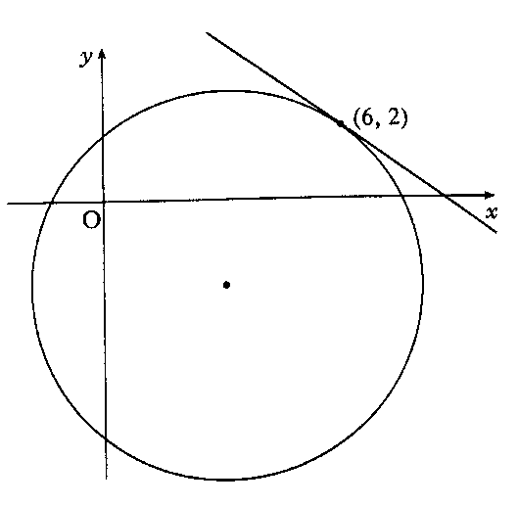
Maths4Scotland Higher
The circle shown has equation
Find the equation of the tangent at the point (6, 2).
Calculate centre of circle:
Calculate gradient of radius (to tangent)
Gradient of tangent:
Equation of tangent:
Hint
Previous
Quit
Quit
Next

Slide 50
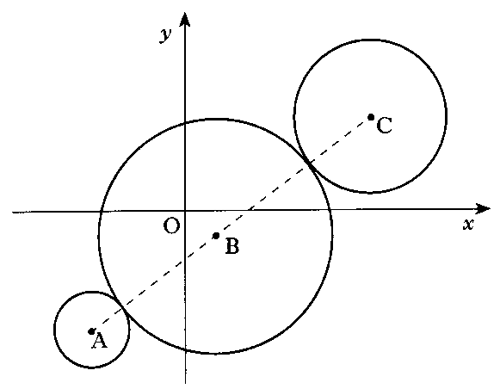
Maths4Scotland Higher
When newspapers were printed by lithograph, the newsprint had
to run over three rollers, illustrated in the diagram by 3 circles.
The centres A, B and C of the three circles are collinear.
The equations of the circumferences of the outer circles are
Find the equation of the central circle.
(24, 12)
Find centre and radius of Circle A
25
Find centre and radius of Circle C
B
27
20
Find distance AB (distance formula)
(-12, -15)
36
Find diameter of circle B
Use proportion to find B
Centre of B
Equation of B
Hint
Previous
Quit
Quit
Next

Slide 51
Are you on Target !
Update you log book
Make sure you complete and correct
ALL of the Circle questions in the
past paper booklet.

